Slide 1

DEPARTMENT OF COLLEGIATE
& TECHNICAL EDUCATION
DEPARTMENT OF
COMPUTER SCIENCE AND ENGINEERING
PRESENTATION ON CYBER SECURITY
PRESENTED BY:
PRUTHVI T & VAISHNAVI S

Slide 2



AGENDA
DIGITAL UNDERWORLD
CYBER CRIME
PRIVACY IN DIGITAL AGE
BUILDING A STRONG DIGITAL SHIELD
ETHICAL HACKING IN CYBER SECURITY
AI – FOE OR FRIEND

Slide 3
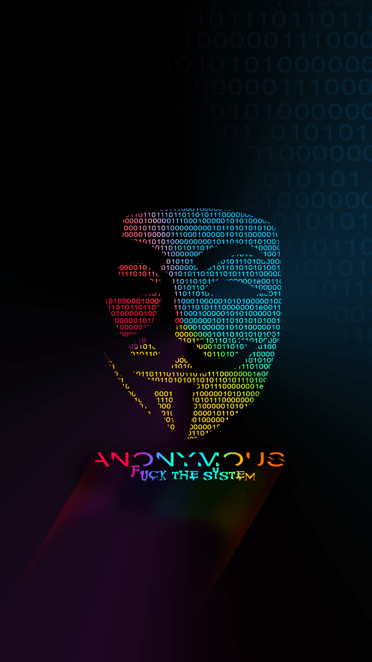
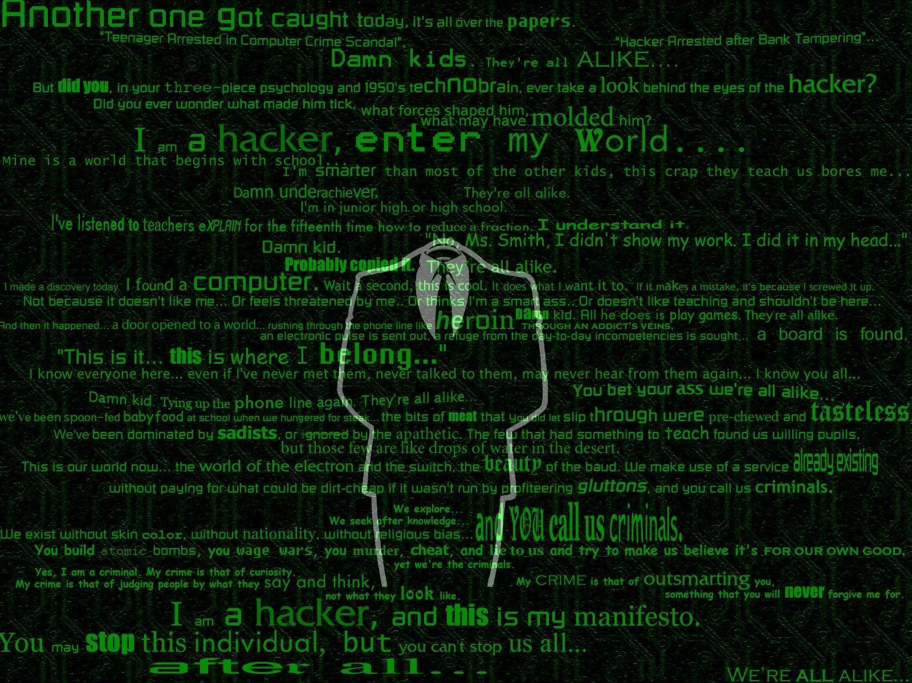





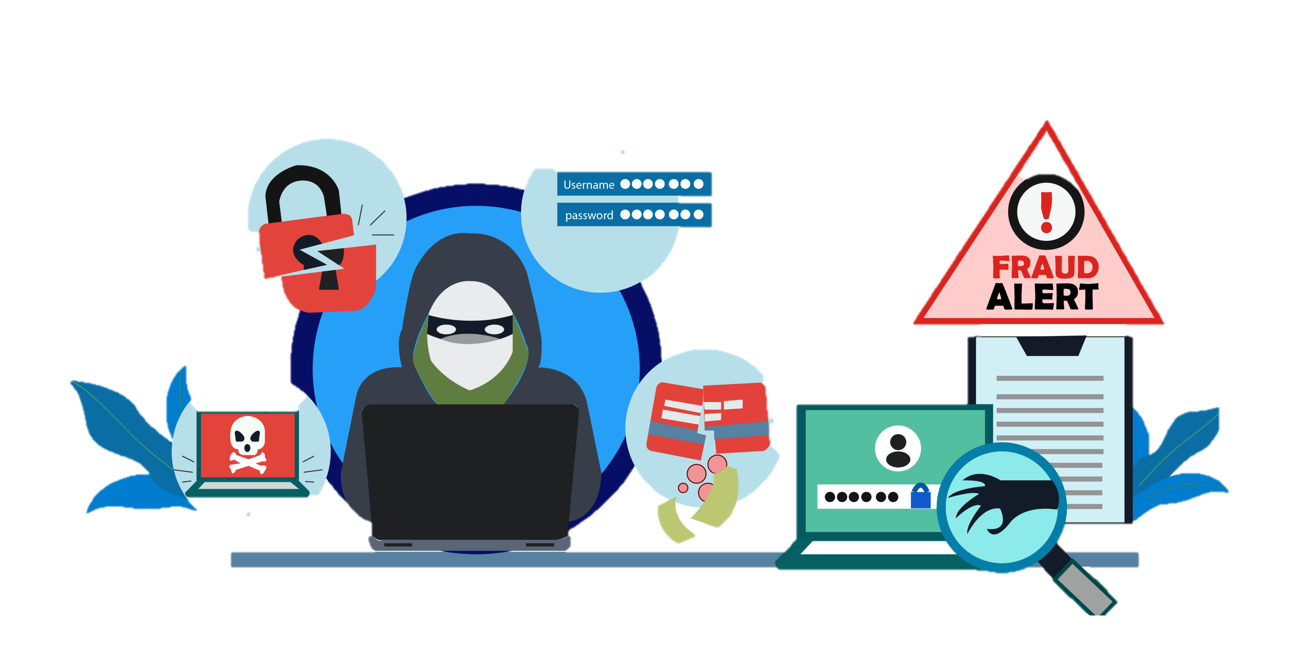
DIGITAL UNDERWORLD
The digital underworld refers to the hidden, often illegal activities that take place online.
This includes a wide range of activities, from cybercrime to extremist ideologies.
It is often associated with the dark web, a network of websites that are not indexed by search engines and are accessible only through specialized browsers.

Slide 4
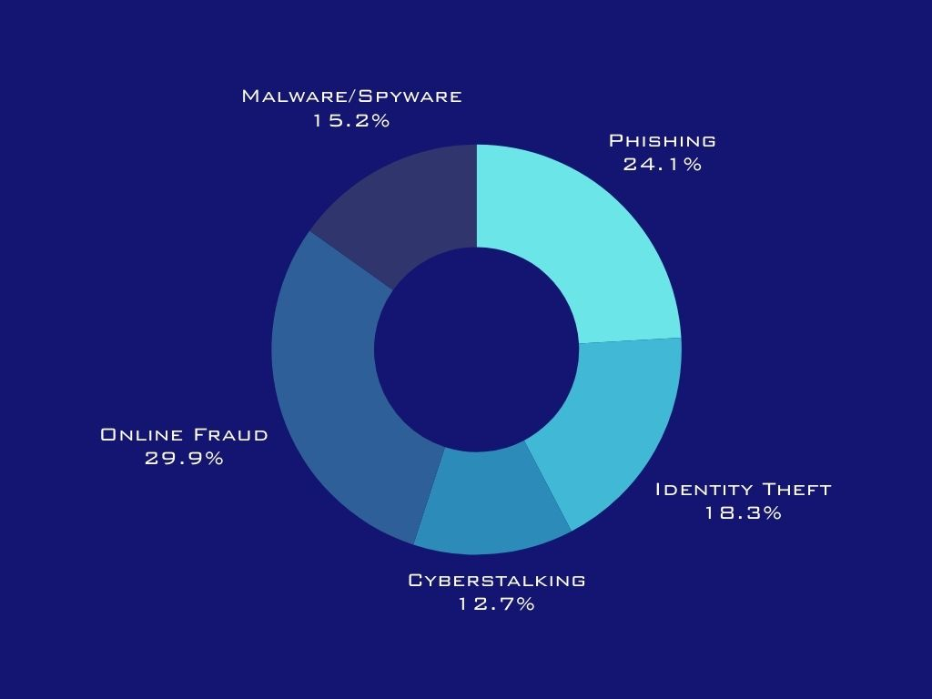
CYBER - CRIME
Cybercrime is a pervasive threat in today's digital age, encompassing a wide range of malicious activities that target individuals, businesses, and governments.
From phishing scams to ransomware attacks, cybercriminals employ sophisticated techniques to exploit vulnerabilities and steal valuable data.

Slide 5

CYBER CRIMES IN INDIA
Cybercrime in India has been a growing concern in recent years, with a significant increase in reported cases.

Slide 6



PRIVACY IN DIGITAL AGE
The digital age has brought about unprecedented advancements in technology, but it has also created new challenges for protecting our privacy.
As we increasingly rely on digital platforms for our daily lives, our personal information is being collected, stored, and used in ways that were unimaginable just a few decades ago.

Slide 7

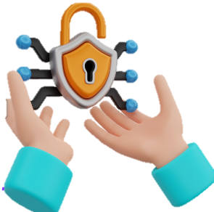

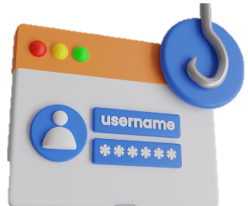
BUILDING A STRONG DIGITAL SHIELD
Strong Passwords
Multi-Factor Authentication (MFA)
Be aware of Phishing Attempts
Data Backup
Limit Sharing of Personal Information

Slide 8
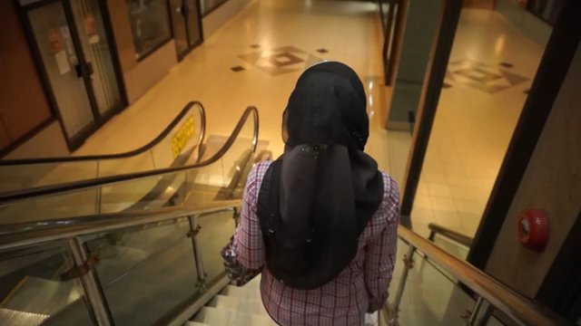

Slide 9
Ethical hacking in
cyber security
Identifies security weaknesses
Prevents data breach and cyber attacks
Monitors the dark web for threats
Supports incident response and forensics
Enhances security awarenesses and training

Slide 10
AI – FOE OR FRIEND
Artificial intelligence (AI) has the potential to revolutionize our world, but it also raises significant concerns about its impact on society.
Whether AI is a foe or friend depends on how it is developed and used.
On the one hand, AI can offer numerous benefits, such as increased efficiency, enhanced decision-making, innovation, and improved quality of life.
AI can automate tasks, analyze large amounts of data, drive progress in various fields, and address societal challenges.

Slide 11


PRIVACY MEASURES
CHROME
THREE VERTICAL DOTS
SETTINGS
SITE SETTINGS
DISABLE
MICROPHONE
CAMERA
LOCATION

Slide 12
CONCLUSION
We concluded the presentation by saying that is government taking care about the cyber security
Yes, many governments around the world are now actively raising cybersecurity awareness through phone calls, SMS alerts, and public campaigns. These initiatives aim to educate citizens about online threats and promote safe internet practices.
We are exploring the vast landscape of cybersecurity, we've uncovered the hidden threats lurking in the digital underworld, the rising tide of cybercrime, and the critical importance of privacy in the digital age.
As technology advances, so do the tactics of cybercriminals, making it essential for us to build a strong digital shield to safeguard our data and systems.
We’ve also seen how ethical hacking plays a pivotal role in identifying vulnerabilities before malicious actors can exploit them. And with the rise of AI, the question isn’t just whether it’s a foe or a friend, but how we can harness its power responsibly to strengthen our defenses.
Ultimately, cybersecurity is not just about technology it’s about people, awareness, and proactive action. By staying informed, vigilant, and ethical, we can navigate the digital world more securely. Thank you.

Slide 13

THANK YOU

